Slide 1

The Fourth Hour!
Welcome to…
Notes:
include fileIO
these slides mainly focus on classes bc that is what is new you can go over testing quick

Slide 2
Introduction
Welcome to the Fourth Hour!
Name
Professor
A fun fact about you

Slide 3
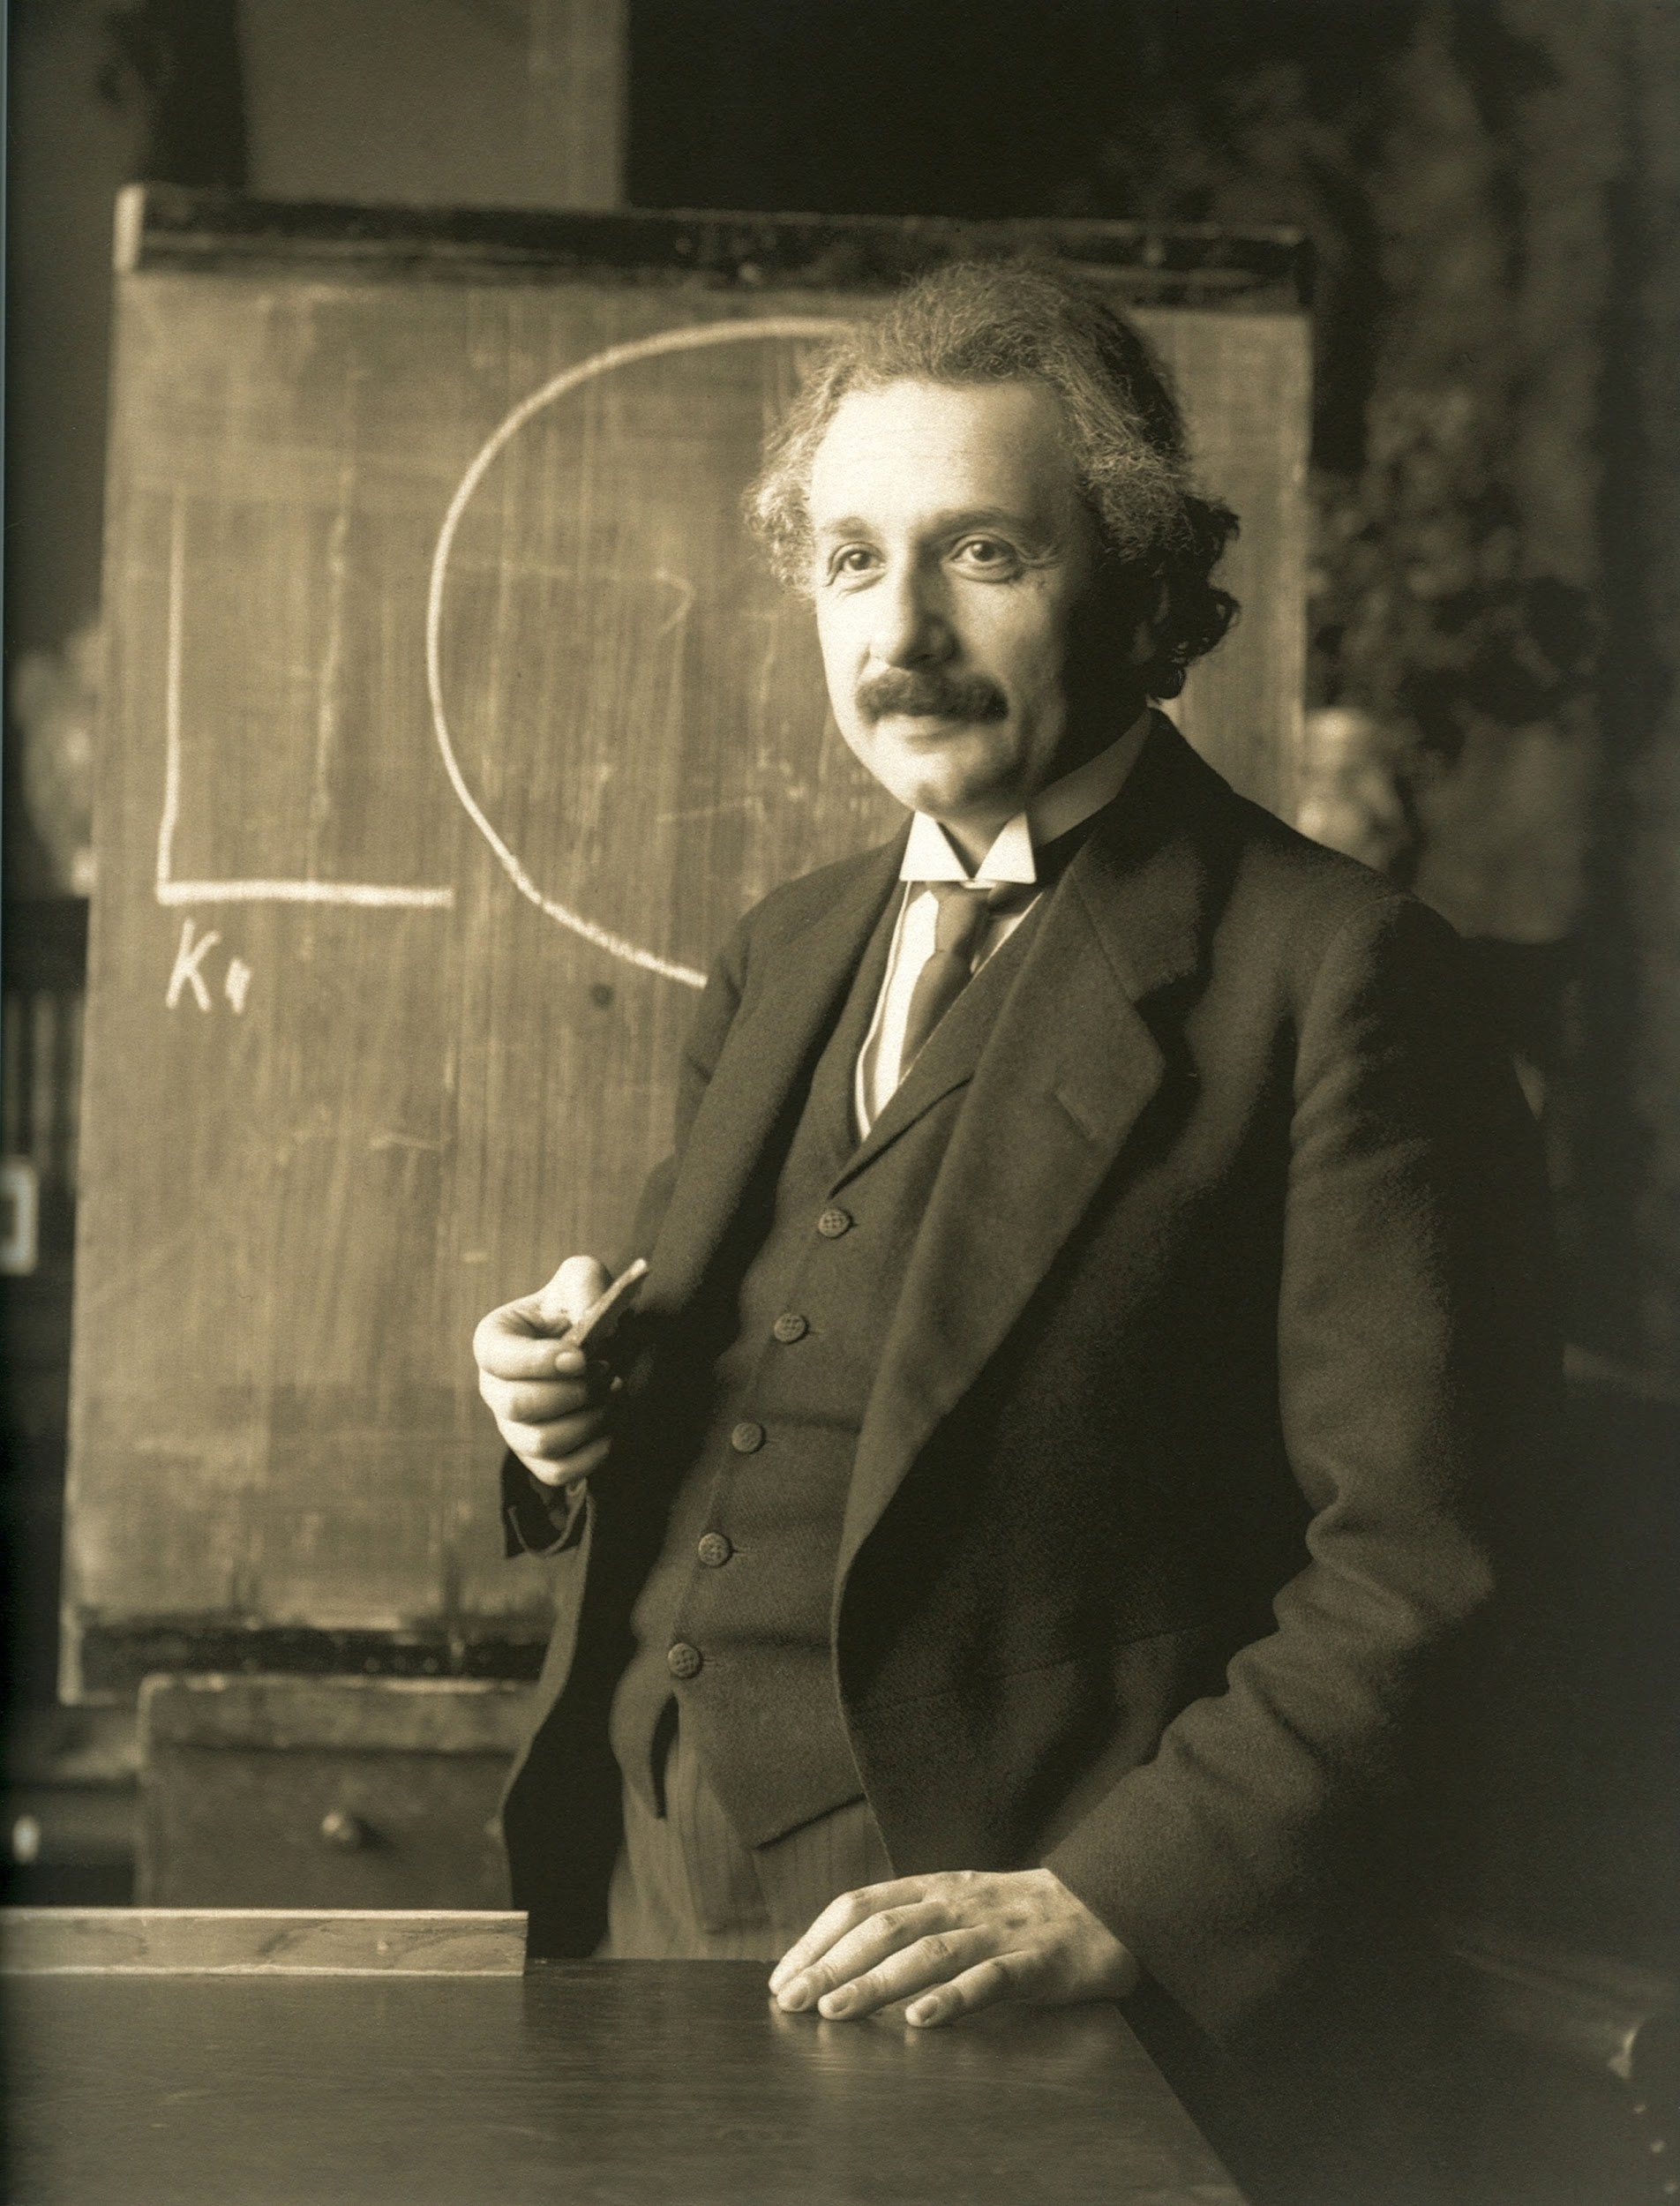
“Anyone who has never made a mistake has never tried anything new.”

Slide 4
How do we write test cases?
We can write test cases several ways:
The first way is to print the results of function calls in our program, either in a main function or any place in the program.

Slide 5
How do we write test cases?
We can write test cases several ways:
The first way is to print the results of function calls in our program, either in a main function or any place in the program.
For example:
print(“foo test with value 3 was:”, foo(3))
print(“Expected the value to be: foo”)

Slide 6
What we have been doing…
print(“foo test with value 5:”, foo(5)) print (“Expected the value to be: bob”)
print(“foo test with value 15:”, foo(15)) print(“Expected the value to be: foobob”)
print(“foo test with value 4:”, foo(4)) print(“Expected the value to be: ”)

Slide 7
Testing with AssertEquals
Let’s write some tests with AssertEquals for this method, here is an example.
def test_foo(self):
self.assertEqual(“foo”, foo(3))

Slide 8
Testing with AssertEquals
Let’s write some tests with AssertEquals for this method, here is an example.
def test_foo(self):
self.assertEqual(“foo”, foo(3))
self.assertEqual(“foobob”, foo(15))
self.assertEqual(“bob”, foo(5))
self.assertEqual(“”, foo(4))

Slide 9
Methods to test…
def exclamation(word):
return (word + "!")
def question(word):
return (word + "?")
Notes:
boundary cases, testing with a main, fill in the blank socrative questions

Slide 10
Methods to test…
def exclamation(word):
return (word + "!")
def question(word):
return (word + "?")
def test_exclamation(self):
expected = “Thanks!”
actual = exclamation(“Thanks”)
self.assertEqual(expected, actual)
Notes:
boundary cases, testing with a main, fill in the blank socrative questions

Slide 11
Methods to test…
def exclamation(word):
return (word + "!")
def question(word):
return (word + "?")
def test_exclamation(self):
expected = “Thanks!”
actual = exclamation(“Thanks”)
self.assertEqual(expected, actual)
def test_question(self):
expected = “Thanks?”
actual = exclamation(“Thanks”)
self.assertEqual(expected, actual)
Notes:
boundary cases, testing with a main, fill in the blank socrative questions

Slide 12
Methods to test… (Shorthand)
def exclamation(word):
return (word + "!")
def question(word):
return (word + "?")
def test_exclamation(self):
self.assertEqual(“Thanks!”, exclamation(“Thanks”))
def test_question(self):
self.assertEqual(“Thanks?”, exclamation(“Thanks”))
Notes:
boundary cases, testing with a main, fill in the blank socrative questions

Slide 13
Review
Login to Socrative at https://b.socrative.com/login/student/
Use code 4thHour149

Slide 14
Question 1 - PI
(1): max([1, 2, 3, 4])
(2): 4
(1): 4
(2): max([1, 2, 3, 4])
(1): max(4)
(2): [1, 2, 3, 4]
(1): [1, 2, 3, 4]
(2): max(4)
Given the function max that takes a list
and finds the max, fill in the blanks to
write the unittest.
def test_max(self):
expected = (1)
actual = (2)
self.assertEqual(expected, actual)

Slide 15
Question 1 - PI
(1): max([1, 2, 3, 4])
(2): 4
(1): 4
(2): max([1, 2, 3, 4])
(1): max(4)
(2): [1, 2, 3, 4]
(1): [1, 2, 3, 4]
(2): max(4)
Given the function max that takes a list
and finds the max, fill in the blanks to
write the unittest.
def test_max(self):
expected = (1)
actual = (2)
self.assertEqual(expected, actual)

Slide 16
What do I do if my code doesn’t pass my tests?
Debug!
It’s okay if you’re not super comfortable with it yet. It can be daunting, so we’ll go through an example together!

Slide 17
Debugging using print statements
Below is some code with errors:
def calc_total (inital_cost, discount, tax_rate): new_total = inital_cost - discount new_total = new_total + (new_total * (tax_rate // 100)) return new_total
Let’s settle on test values, then use print statements to see what’s going on.
Notes:
Online python compiler link with code: https://onlinegdb.com/BhOxzGGuR
Or just run locally so u can run through print statements and thinking

Slide 18
Debugging using print statements
Below is some code with errors:
def calc_total (inital_cost, discount, tax_rate): new_total = inital_cost - discount print(“after discount”, new_total) new_total = new_total + (new_total * (tax_rate // 100)) return new_total
Notes:
Online python compiler link with code: https://onlinegdb.com/BhOxzGGuR
Check what the value of new_total is after the first line. With values (15, 5, 10), it should be 10.

Slide 19
Debugging using print statements
Below is some code with errors:
def calc_total (inital_cost, discount, tax_rate): new_total = inital_cost - discount print(“after discount”, new_total) new_total = new_total + (new_total * (tax_rate // 100)) return new_total
Notes:
Online python compiler link with code: https://onlinegdb.com/BhOxzGGuR
Printed line matches what we expected. Our next statement must be the problem

Slide 20
Debugging using print statements
Below is some code with errors:
def calc_total (inital_cost, discount, tax_rate): new_total = inital_cost - discount print(“after discount”, new_total) new_total = new_total + (new_total * (tax_rate // 100)) print(“after tax”, new_total) return new_total
Notes:
Online python compiler link with code: https://onlinegdb.com/BhOxzGGuR
Check what the new_total is after our second statement. With test values (15, 5, 10) it should be 11

Slide 21
Debugging using print statements
Below is some code with errors:
def calc_total (inital_cost, discount, tax_rate): new_total = inital_cost - discount print(“after discount”, new_total) new_total = new_total + (new_total * (tax_rate // 100)) print(“after tax”, new_total) return new_total
Notes:
Online python compiler link with code: https://onlinegdb.com/BhOxzGGuR
That gave us the wrong answer, check the calculation we’re doing

Slide 22
Debugging using print statements
Below is some code with errors:
def calc_total (inital_cost, discount, tax_rate): new_total = inital_cost - discount print(“after discount”, new_total) new_total = new_total + (new_total * (tax_rate // 100)) print(“tax amount”, new_total * (tax_rate // 100))) print(“after tax”, new_total) return new_total
Notes:
Online python compiler link with code: https://onlinegdb.com/BhOxzGGuR
Should give us $1 with values (15, 5, 10)

Slide 23
Debugging using print statements
Below is some code with errors:
def calc_total (inital_cost, discount, tax_rate): new_total = inital_cost - discount print(“after discount”, new_total) new_total = new_total + (new_total * (tax_rate // 100)) print(“tax amount”, new_total * (tax_rate // 100))) print(“after tax”, new_total) return new_total
Notes:
Online python compiler link with code: https://onlinegdb.com/BhOxzGGuR
Should give us $1 with values (15, 5, 10)

Slide 24
Debugging using print statements
Changing from integer division to regular division fixes our problem!
def calc_total (inital_cost, discount, tax_rate): new_total = inital_cost - discount print(“after discount”, new_total) new_total = new_total + (new_total * (tax_rate / 100)) print(“tax amount”, new_total * (tax_rate / 100))) print(“after tax”, new_total) return new_total
Notes:
Online python compiler link with code: https://onlinegdb.com/BhOxzGGuR
Updated code returns $11
Even though python defaults to float division, getting the idea of types and the difference between different operations is important

Slide 25
Classes.

Slide 26
What are classes?
Classes allow us to encapsulate data and write functions that allow us to access the…
Data properties of a class
Modify the data properties of a class
Perform actions with the class

Slide 27
What kind of objects have we used before?
int
str
list
Each of these types has their own methods such as append and isdigit

Slide 28
What are the 3 main parts of a class?
When defining your own class you should have…

Slide 29
What are the 3 main parts of a class?
When defining your own class you should have…
Constructor
Attributes (instance variables)
Functions

Slide 30
What does a Constructor do?
Constructors are used for instantiating an object. The main thing that they must do is initialize the attributes of the class.
Example from POGIL:
def __init__(self, symbol, atomic, mass, isotope=12):
"""Constructs an Atom with the given values."""
self.symbol = symbol
self.atomic = atomic
self.mass = mass
self.isotope = isotope
Notes:
oxygen = Atom('O', 8, 15.999, 16)
carbon = Atom('C', 6, 12.001)

Slide 31
What are Attributes (Instance Variables)
Attributes are the variables defined directly in the class that are initialized by the constructor.
Example from POGIL:
def __init__(self, symbol, atomic, mass, isotope=12):
"""Constructs an Atom with the given values."""
self.symbol = symbol
self.atomic = atomic
self.mass = mass
self.isotope = isotope

Slide 32
What are class functions?
Class functions are functions that manipulate data specific to the class.
*Notice the keyword self is always a parameter*
def grams_to_atoms(self, weight):
"""Converts the mass of an element in grams to number of atoms."""
answer = Atom.avogadros * self.grams_to_moles(weight)
print("%.1f g is %.1e atoms of %s" % (weight, answer, self.symbol))
return answer

Slide 33
Question 2
Given the following code, how would we print the attribute mass?
oxygen = Atom('O', 8, 15.999, 16)
def __init__(self, symbol, atomic, mass, isotope=12):
self.symbol = symbol
self.atomic = atomic
self.mass = mass
self.isotope = isotope
print(oxygen.mass)
print(mass)
print(Atom.mass)
print(oxygen[3])

Slide 34
Question 2
Given the following code, how would we print the attribute mass?
oxygen = Atom('O', 8, 15.999, 16)
def __init__(self, symbol, atomic, mass, isotope=12):
self.symbol = symbol
self.atomic = atomic
self.mass = mass
self.isotope = isotope
print(oxygen.mass)
print(mass)
print(Atom.mass)
print(oxygen[3])

Slide 35
Let’s write a class!
Make a class called Vehicle that has the attributes make, model, and year.

Slide 36
Let’s write a class!
Make a class called Vehicle that has the attributes make, model, and year.
Now that we have the class written… how would we…
Make an object called truck that has the attributes Ford F-150 2021

Slide 37
Let’s write a class!
Make a class called Vehicle that has the attributes make, model, and year.
Now that we have the class written… how would we…
Make an object called truck that has the attributes Ford F-150 2021
truck = Vehicle(“Ford”, “F-150”, 2021)

Slide 38
Let’s write a class!
Make a class called Vehicle that has the attributes make, model, and year.
Now that we have the class written… how would we…
Make an object called truck that has the attributes Ford F-150 2021
truck = Vehicle(“Ford”, “F-150”, 2021)
Now, how would we print these attributes so they are easy to read?

Slide 39
Let’s write a class!
Now, how would we print these attributes so they are easy to read?
print(“Make:”, truck.make, “Model:”, truck.model, “Year:”, truck.year)
It’s pretty annoying to have to write that for every Vehicle we make… how can we fix this?

Slide 40
Let’s write a class!
Now, how would we print these attributes so they are easy to read?
print(“Make:”, truck.make, “Model:”, truck.model, “Year:”, truck.year)
It’s pretty annoying to have to write that for every Vehicle we make… how can we fix this?
a class function!
Write a class function that prints the make, model, and year as seen above

Slide 41
Let’s write a class!
Write a class function that prints the make, model, and year as seen above
def format(self):
print(“Make:”, self.make, “Model:” self.model, “Year:”, self.year)
then print with:
print(truck.format())
def __str__(self):
return(“Make:”, self.make, “Model:” self.model, “Year:”, self.year)
then print with:
print(truck)

Slide 42
Question 3 - PI
Given the following code what is printed?
truck1 = Vehicle(“Ford”, “F-150”, 2021)
truck2 = Vehicle(“Ford”, “F-150”, 2021)
if truck1 is truck2:
print(“True”)
else:
print(“False”)
True
False
TrueFalse
Error

Slide 43
Question 3 - PI
Given the following code what is printed?
truck1 = Vehicle(“Ford”, “F-150”, 2021)
truck2 = Vehicle(“Ford”, “F-150”, 2021)
if truck1 is truck2:
print(“True”)
else:
print(“False”)
True
False
TrueFalse
Error

Slide 44
Let’s write an equals method
Write an equals method for our vehicle class. It should return True if all the attributes are the same and False if any of them are different.

Slide 45
Let’s write an equals method
Write an equals method for our vehicle class. It should return True if all the attributes are the same and False if any of them are different.
def __eq__ (self, other):
return (isinstance(other, Vehicle) and self.make == other.make and
self.model == other.model and self.year == other.year)

Slide 46
Question 4
Given the following code what is printed? (Remember we just added an equals method)
truck1 = Vehicle(“Ford”, “F-150”, 2021)
truck2 = Vehicle(“Ford”, “F-150”, 2021)
if truck1 == truck2:
print(“True”)
else:
print(“False”)
True
False
TrueFalse
Error

Slide 47
Question 4
Given the following code what is printed? (Remember we just added an equals method)
truck1 = Vehicle(“Ford”, “F-150”, 2021)
truck2 = Vehicle(“Ford”, “F-150”, 2021)
if truck1 == truck2:
print(“True”)
else:
print(“False”)
True
False
TrueFalse
Error

Slide 48
Let’s Write a Constructor
Make a constructor that creates a Television object that has the attributes: size, make, and resolution. If no resolution is given it should be assumed to be 1080.

Slide 49
Let’s Write a Constructor
Make a constructor that creates a Television object that has the attributes: size, make, and resolution. If no resolution is given it should be assumed to be 1080.
def __init__(self, size, make, resolution=1080):
"""Constructs an Television with the given values."""
self.size = size
self.make = make
self.resolution = resolution

Slide 50
Let’s Write a __str__ function
Write a __str__ function that prints the size, make, and resolution

Slide 51
Let’s Write a __str__ function
Write a __str__ function that prints the size, make, and resolution
def __str__(self):
return “Size: ” + self.size + “Make: ” + self.make + “Resolution: ” + self.resolution + “p”
then print with:
???

Slide 52
Let’s Write a __str__ function
Write a __str__ function that prints the size, make, and resolution
def __str__(self):
return “Size: ” + self.size + “Make: ” + self.make + “Resolution: ” + self.resolution + “p”
then print with:
tv1= Television(55, “Samsung”)
print(tv1)
Size: 55 Make: Samsung Resolution: 1080p

Slide 53
Let’s Write a __eq__ function
Write an __eq__ method for our television class. It should return True if all the attributes are the same and False if any of them are different.
Notes:
tv1= Atom(55, “Samsung”)
tv2= Atom(55, “Samsung”, 1080)
tv1 == tv2 # True

Slide 54
Let’s Write a __eq__ function
Write an __eq__ method for our television class. It should return True if all the attributes are the same and False if any of them are different.
def __eq__ (self, other):
return (isinstance(other, Television) and self.size == other.size and
self.make == other.make and self.resolution == other.resolution)
Notes:
tv1= Atom(55, “Samsung”)
tv2= Atom(55, “Samsung”, 1080)
tv1 == tv2 # True

Slide 55
Let’s Write a __eq__ function
Write an __eq__ method for our television class. It should return True if all the attributes are the same and False if any of them are different.
def __eq__ (self, other):
return (isinstance(other, Television) and self.size == other.size and
self.make == other.make and self.resolution == other.resolution)
tv1=Television(55, “Samsung”)
tv2=Television(55, “Samsung”)
print(tv1 == tv2) # True

Slide 56
Challenge Problem 1
Using a nested for loop, print all the names in the list 4 times.
names = [‘Carter’, ‘Maddie’, ‘Cory’, ‘Alyssa’]
Carter Carter Carter Carter
Maddie Maddie Maddie Maddie
Cory Cory Cory Cory
Alyssa Alyssa Alyssa Alyssa
Notes:
names = [‘Carter’, ‘Maddie’, ‘Cory’, ‘Alyssa’]
for name in names:
# inner while loop
for i in range(4):
print(name, end=' ')
print()

Slide 57
Challenge Problem 2
Using 2 nested for loops, draw the following:
*
* *
* * *
* * * *
* * * * *
* * * *
* * *
* *
*
Notes:
HINT SPLIT THIS PROBLEM INTO 2 PARTS. don't do this as while loop it just seems toxic at this point they get the idea. explain why it is toxic to do it as a while loop tho
n=5;
for i in range(n):
for j in range(i):
print ('* ', end="")
print('')
for i in range(n,0,-1):
for j in range(i):
print('* ', end="")
print('')

Slide 58
Challenge Problem 3
Using a nested for loop print a multiplication table. Output should be:
1 2 3 4 5 6 7 8 9 10
2 4 6 8 10 12 14 16 18 20
3 6 9 12 15 18 21 24 27 30
4 8 12 16 20 24 28 32 36 40
5 10 15 20 25 30 35 40 45 50
6 12 18 24 30 36 42 48 54 60
7 14 21 28 35 42 49 56 63 70
8 16 24 32 40 48 56 64 72 80
9 18 27 36 45 54 63 72 81 90
10 20 30 40 50 60 70 80 90 100
Notes:
for i in range(1, 11):
# to iterate from 1 to 10
for j in range(1, 11):
# print multiplication
print(i * j, end=' ')
print()

